Slide 1


RecSys Challenge 2019
Team Members:
Daniel Zhang
Matthew Millendorf
Wenxiao Xiao

Slide 2
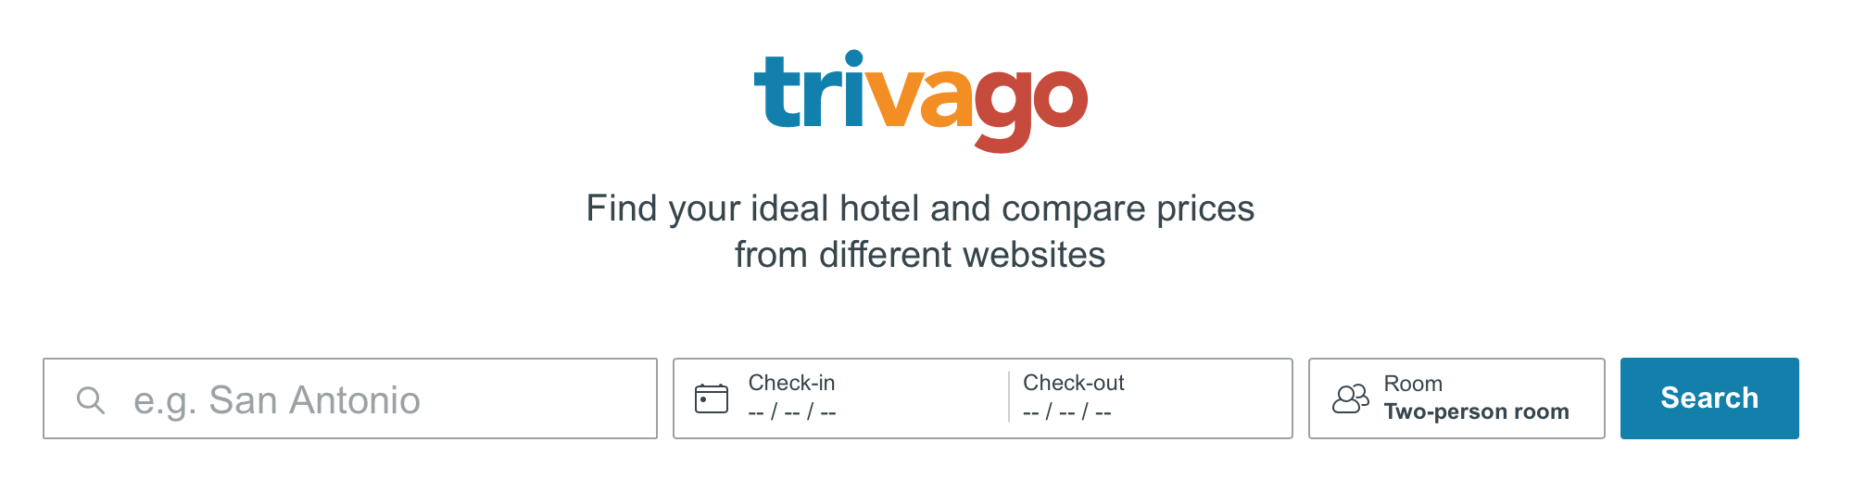
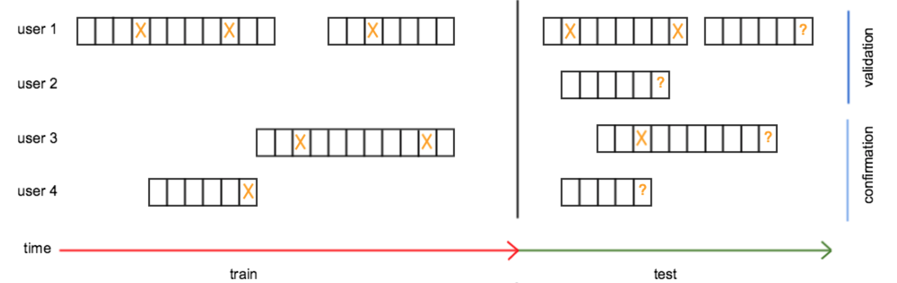
Problem & Goal
Session-based user behaviour:
E.g. filter usage, search refinements, item interactions, item searches, item click-outs
Goal:
Predict the final click-out based on session-based behaviour

Slide 3
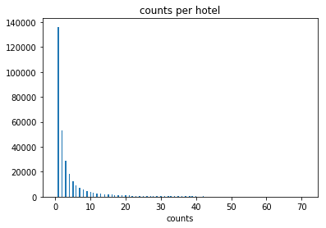
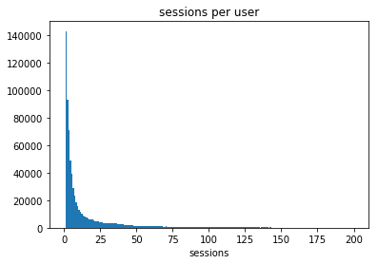
Data Source & Summary
Metadata: features of each hotel, 927142 hotels with 157 properties
Train_data: users’ filter criteria, historical clickouts, users’ action, candidates hotel for each search session
Test_data: including all features existed in train dataset except theres is a missing clickout for each user which need to be predicted

Slide 4
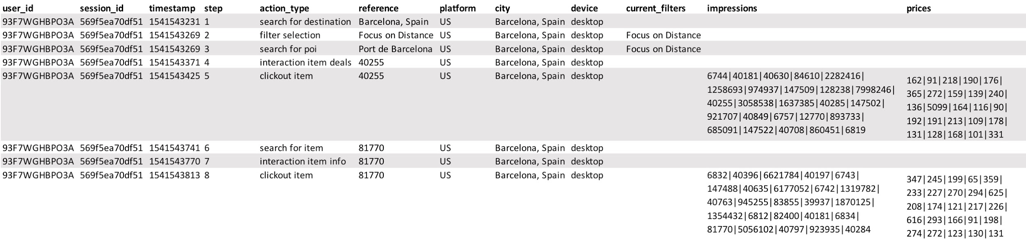
Sample Data
Session based user action and the final click out items

Slide 5
Modeling
Popularity Baseline
The popularity baseline model is provided by challenge host
This model sums the clickouts for each hotels and ranked the recommendations base on the summation
Although it only uses the clickout information, the result is surprisingly good for such a naive model
The performance is 0.288448
Notes:
Normalize feature, then calculate the Euclid distance between two dogs on the feature space

Slide 6
Modeling
Utility Matrix
We tried to build a utility matrix for the user-item interactions
Firstly we tried to sum all clickouts for each user-item pairs, just like the popularity baseline
Then we choose six user action types and assign weights to each action, use the the summation for each user-item pairs
Notes:
Normalize feature, then calculate the Euclid distance between two dogs on the feature space

Slide 7
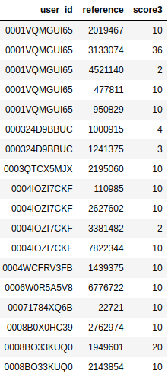
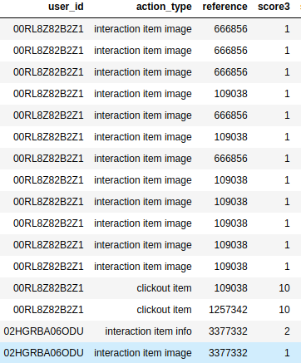
Modeling
Utility Matrix
Notes:
Normalize feature, then calculate the Euclid distance between two dogs on the feature space

Slide 8
Modeling
Collaborative Filtering & SVD
Co-clustering and SVD maybe be a good choose for the dataset
Use a RecSys package Surprise to perform sparse co-clustering and sparse SVD on the utility matrix
Users are assigned into 4 clusters and items are assigned into 2 clusters with k-means clustering
The performance is 0.201237 & 0.21925
One possible explanation is the data is too sparse for these method
Notes:
Normalize feature, then calculate the Euclid distance between two dogs on the feature space

Slide 9
Modeling
Rank By Utility Matrix
Only change the user-item pairs existing in utility matrix
Use popularity baseline to avoid cold start
For each line in the popularity baseline submission, find all user-items pairs existing in utility matrix, rank the items by the utility, and put them the front of recommendations
The result varies on how we assign weights to user interaction, and the best result is 0.500554
Notes:
Normalize feature, then calculate the Euclid distance between two dogs on the feature space

Slide 10

Key Takeaways
Feature is the king
Dive into the data and find out the set of features that are relevant to what we gonna predict
Start with a Strategic End in mind
Strategic context is critical to maximizing the value of data mining and avoiding the “ad hoc trap”
Notes:
Normalize feature, then calculate the Euclid distance between two dogs on the feature space

Slide 11

Notes:
Normalize feature, then calculate the Euclid distance between two dogs on the feature space

